Slide 1
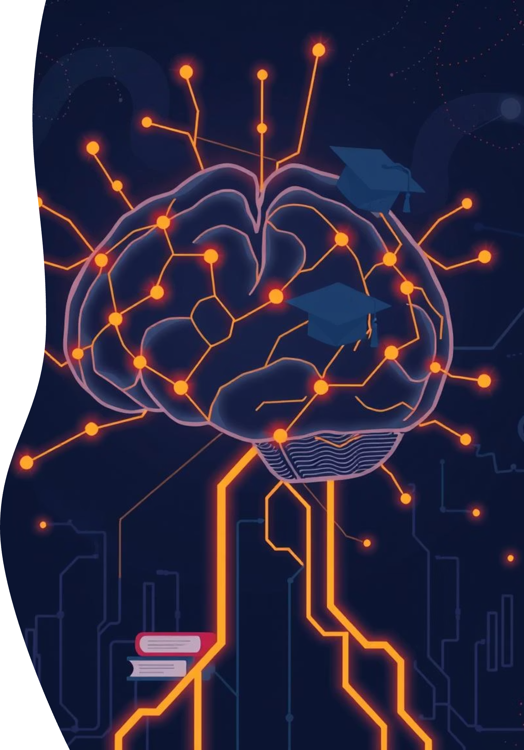
Eklavya AI: The Autonomous Personalized Learning Agent
Revolutionizing education through intelligent, adaptive learning experiences.

Slide 2
The Problem: A Universal Challenge
One-Size-Fits-All Education
Inefficient Learning
Student Stress & Burnout
Students spend excessive time on concepts they already grasp or struggle with material without targeted support.
The pressure of competitive exams and vast syllabus contributes to high levels of anxiety and academic fatigue.
Traditional schooling often fails to cater to individual learning paces and styles, leading to disengagement.
This creates a critical gap, particularly in high-stakes environments, where personalized attention is paramount.

Slide 3

Real-World Impact: Competitive Exams
In highly competitive exam landscapes such as JEE and NEET in India, students face immense pressure. A single weak concept can determine their future. Current solutions offer generic practice, but fail to diagnose and address precise, nuanced weaknesses. Eklavya AI directly tackles this by pinpointing exact knowledge gaps and providing hyper-targeted remediation.
This often leads to wasted effort, prolonged study hours, and underperformance despite dedication.

Slide 4

The Solution: Eklavya AI
Your Autonomous Personalized Learning Agent.
Eklavya AI acts as a proactive, intelligent study partner, constantly analyzing, adapting, and guiding students through their unique learning journeys. It's not just a tool; it's a dedicated companion.

Slide 5








How It Works: The Agentic Flow
Perception
Reasoning
Ingests all learning materials and student interactions.
Identifies precise knowledge gaps and cognitive patterns.
Acting
Planning
Delivers tailored content and continuously evaluates progress.
Generates bespoke, adaptive micro-learning plans.
This continuous feedback loop ensures dynamic adaptation and optimal learning outcomes for every student.

Slide 6
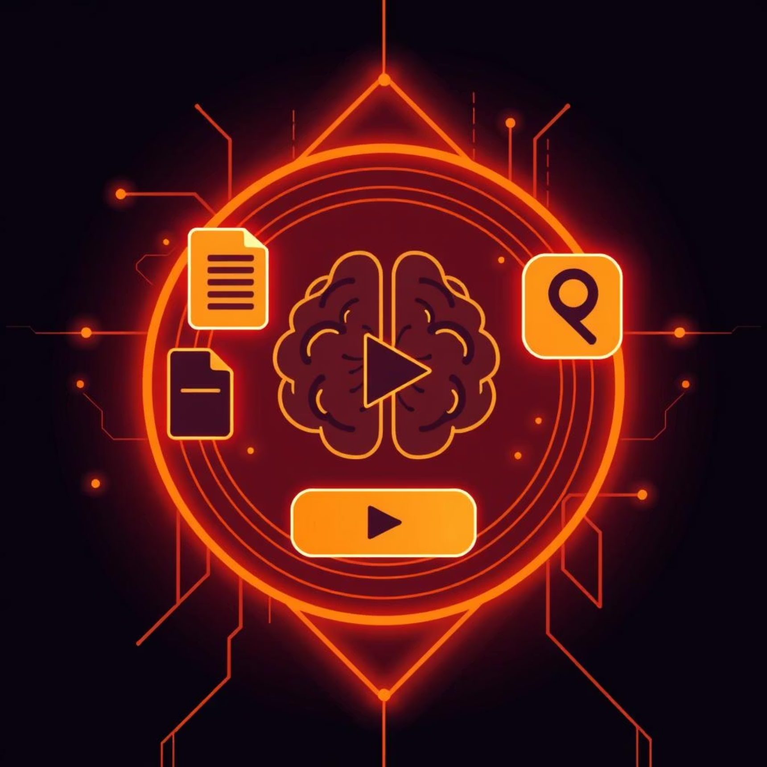
Phase 1: Perception & Input
Eklavya AI intelligently gathers information from diverse sources to build a comprehensive understanding of the student's knowledge base.
Uploads: Notes, PDFs, textbooks, past exam papers.
Multimedia Integration: YouTube links, online lectures.
Diagnostic Quizzes: Adaptive assessments tailored to syllabus topics.
Behavioural Data: Tracks engagement, time spent, and common mistakes.
This holistic input allows Eklavya AI to create a detailed learner profile from day one.

Slide 7

Phase 2: Reasoning & Diagnosis
Beyond just wrong answers, Eklavya AI pinpoints the precise conceptual weakness.
Example: Calculus Weakness
A student struggles with a problem involving derivatives. Instead of concluding "weak in derivatives," Eklavya AI analyzes the incorrect steps and determines the student understands basic differentiation but lacks proficiency in applying the "chain rule" to complex functions.
This granular diagnosis is crucial for effective, targeted intervention, preventing wasted study on already mastered topics.

Slide 8




Phase 3: Planning & Remediation
Upon identifying a weakness, Eklavya AI constructs a dynamic micro-learning plan.
Concise Explanation
Short Video
A focused, bite-sized text explanation of the specific concept.
A curated or AI-generated video demonstrating the concept's application.
Targeted Practice
Quick Quiz
A few custom-generated practice problems relevant to the weakness.
A short assessment to confirm mastery before moving on.
This structured approach ensures efficient knowledge acquisition and retention, tailored precisely to the student's needs.

Slide 9
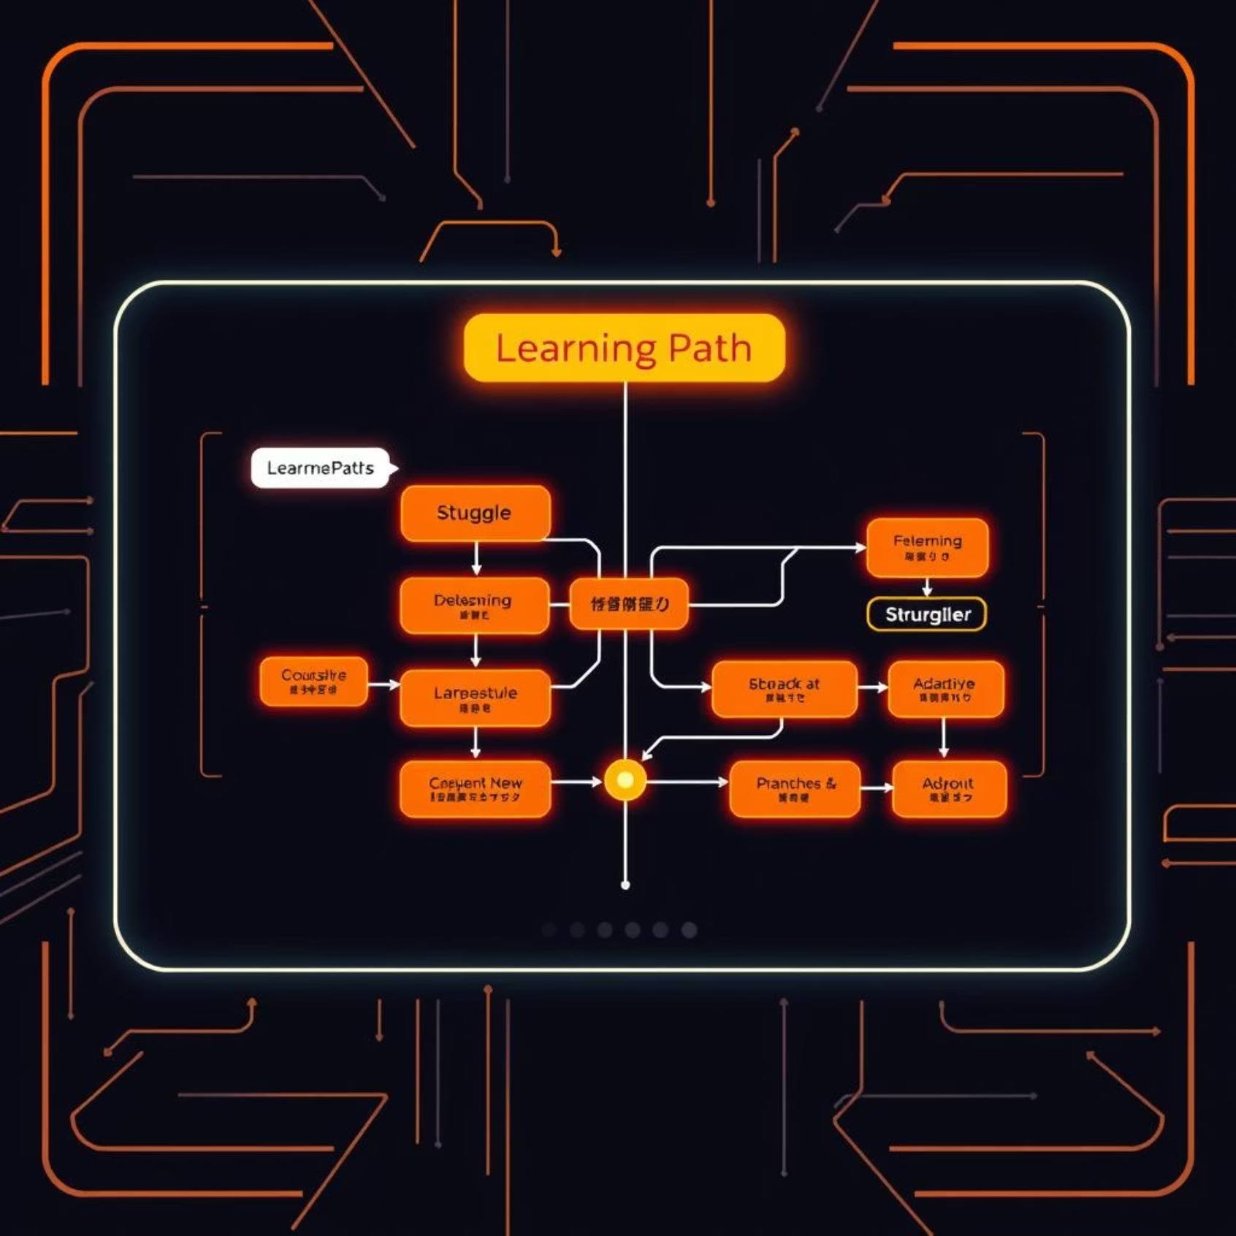
Phase 4: Acting & Adaptation
Eklavya AI deploys the custom learning plan, continuously monitoring the student's engagement and performance. If the student masters the concept, the agent moves on. If they struggle, it automatically adapts:
Reteaching: Offers alternative explanations or different learning modalities.
Simplification: Breaks down the concept into even smaller, more digestible parts.
Review: Schedules spaced repetition for long-term retention.
This autonomous adaptation ensures no student is left behind, or held back, maximizing personalized learning efficiency.

Slide 10
Beyond Tutoring: The Proactive Agent
Eklavya AI is fundamentally different from existing solutions.
Reactive Tutoring
Responds only when a student asks a question.
Relies on student to identify weakness.
Often provides broad explanations.
Eklavya AI: Proactive Agent
Continuously identifies weaknesses before student realizes.
Autonomous diagnosis and remediation.
Delivers hyper-personalized content and plans.
This shift from reactive help to proactive guidance creates a truly transformative learning experience.

Slide 11
Team Resolvian!
Members: Sameer Gupta, Sachin lodhi
Sagar Institute of Science and Technology, Gandhi Nagar, Bhopal

Slide 12

Thank You!
We appreciate your time and attention in learning about Eklavya AI.
Note: Eklavya AI is continuously evolving! We are actively working on integrating even more advanced features, including personalized mentorship, collaborative learning modules, and comprehensive progress analytics, to further revolutionize the learning experience.

